Slide 1
Intro to Neural Network 3
Marlabs

Slide 2
Quick Review
Single Neuron
We now understand how to perform a calculation in a neuron
w · x + b = z
a = σ(z)

Slide 3
Activation Function
Perceptrons
Sigmoid
Tanh
ReLU
Leaky ReLU

Slide 4
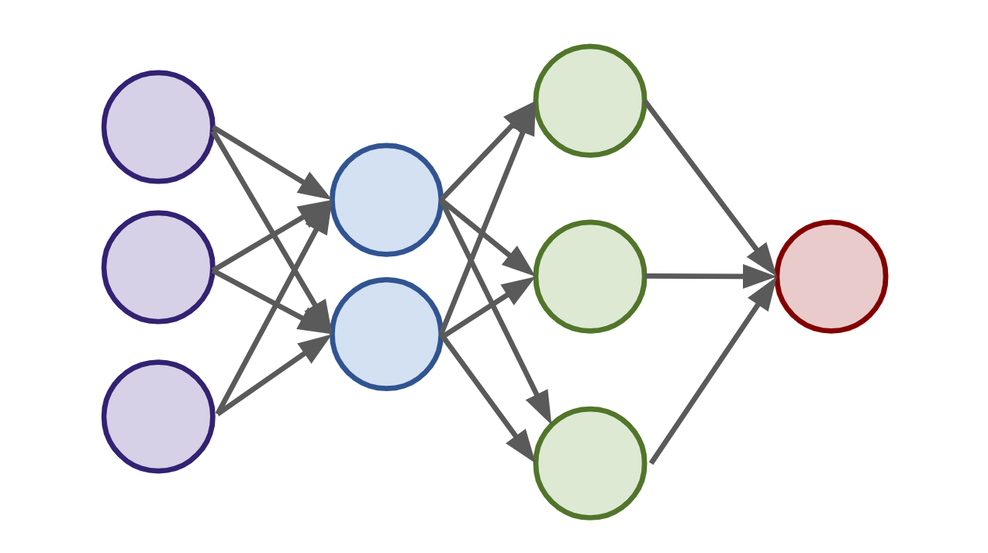
Deep Learning
Connecting Neurons to create a network

Slide 5
Deep Learning
Neural Network
Input Layer
Hidden Layers
Output Layer
More layers → More Abstraction

Slide 6
Deep Learning
To “learn” we need some measurement of error.
We use a Cost/Loss Function
Quadratic
Cross-Entropy

Slide 7
Deep Learning
Once we have the measurement of error, we need to minimize it by choosing the correct weight and bias values.
We use gradient descent to find the optimal values.

Slide 8
Deep Learning
We can then backpropagate the gradient descent through multiple layers, from the output layer back to the input layer.
We also know of dense layers, and later on we’ll introduce softmax layer.

Slide 9
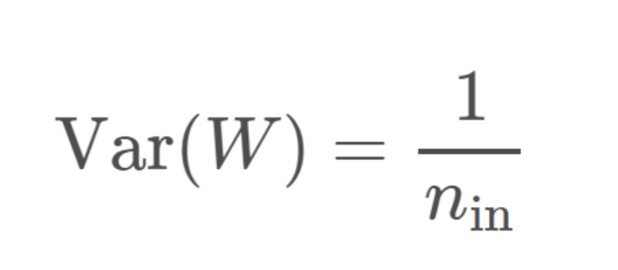
Initialization of Weights Options
Zeros
No Randomness
Not a great choice
Random Distribution Near Zero
Not Optimal
Activation Functions Distortion
Xavier (Glorot) Initialization
Uniform / Normal
Draw weights from a distribution with zero mean and a specific variance

Slide 10
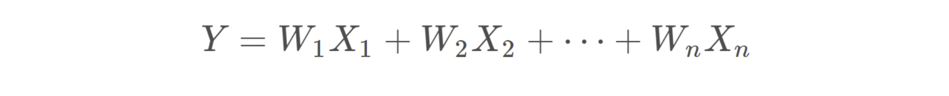
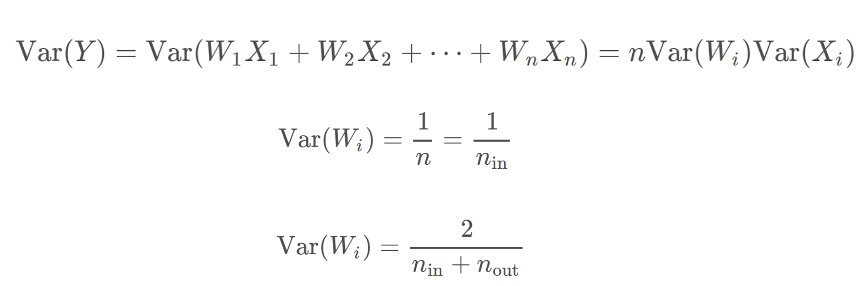

Xavier Initialization
$$Var\left(W_{i}X_{i}\right)=E{\left[X_{i}\right]}^{2}Var\left(W_{i}\right)+E{\left[W_{i}\right]}^{2}Var\left(X_{i}\right)+Var\left(W_{i}\right)Var(X_{i})$$
Assume the expectation is 0.
$$Var\left(W_{i}X_{i}\right)=Var\left(W_{i}\right)Var(X_{i})$$
Assume iid. (independent and identically distributed)
If we have variance of input and variance of out same, then we have:

Slide 11
Deep Learning – Gradient Descent
Learning Rate - defines the step size during gradient descent
Batch Size - batches allow us to use stochastic gradient descent.
Smaller → less representative of data
Larger → longer training time
Second-Order Behavior of the gradient descent allows us to adjust our learning rate based off the rate of descent
AdaGrad
RMSProp
Adam

Slide 12
Deep Learning – Gradient Descent
This allows us to start with larger steps and then eventually go to smaller step sizes.
Adam allows this change to happen automatically.

Slide 13
Deep Learning – Gradient Descent
Unstable / Vanishing Gradients
As you increase the number of layers in a network, the layers towards the input will be affected less by the error calculation occurring at the output as you go backwards through the network
Initialization and Normalization will help us mitigate these issues.

Slide 14
Deep Learning – Overfitting Problem
With potentially hundreds of parameters in a deep learning neural network, the possibility of overfitting is very high!
There are a few ways to help mitigate this issue.

Slide 15
Overfitting Treatment
L1/L2 Regularization
Adds a penalty for larger weights in the model
Not unique to neural networks
Dropout
Unique to neural networks
Remove neurons during training randomly
Network doesn’t over rely on any particular neuron
Expanding Data
Artificially expand data by adding noise, tilting images, adding low white noise to sound data, etc...

Slide 16
TensorFlow Playground
Playground.tensorflow.org

